Slide 1
Conflicts of Interest Induction Training
April 2024
Group Compliance

Slide 2
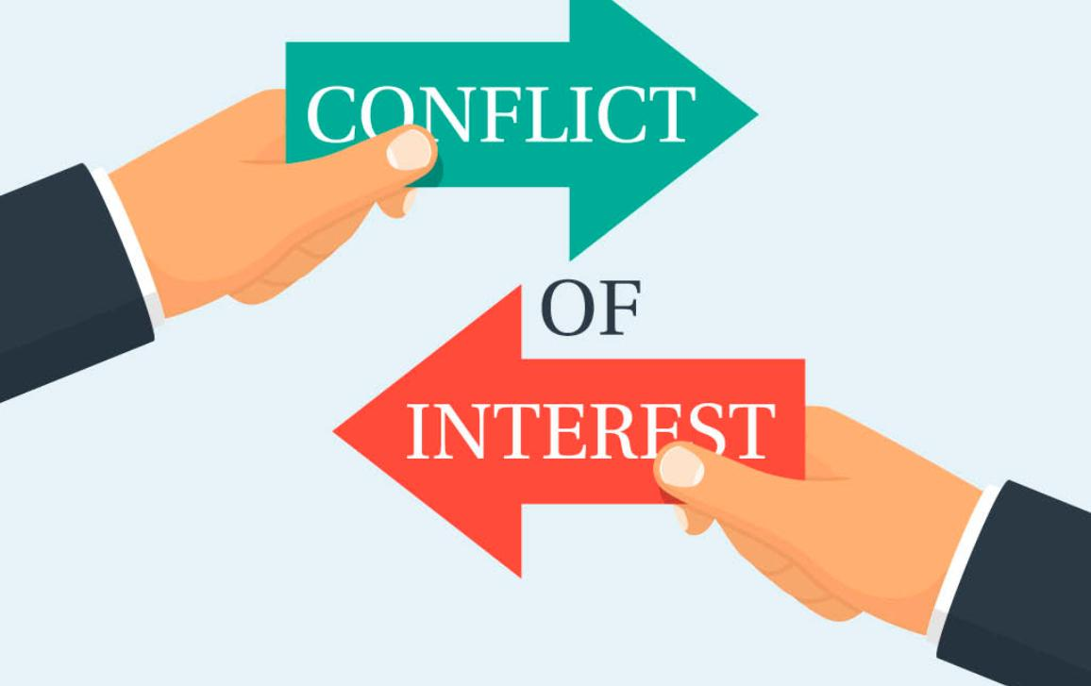
Conflicts of Interest Induction Training
Introduction
At Prudential, we adhere to the highest professional and ethical standards of conduct, which includes our commitment to treating customers fairly. In order to protect the interests of Prudential’s customers, the Group and its employees, we all share the responsibility of identifying and managing conflicts of interest (COIs). Even the perception that personal interests influence business judgement could be detrimental to Prudential or to its key stakeholders such as customers, shareholders, investors and employees.
The term “COI” should be interpreted broadly to capture any actual, perceived or potential situation where the Prudential Group or a Business Unit (BU)/Local Business Unit (LBU) or employee/contractor has a vested interest (commercial, professional and/or personal), that could be seen as having inappropriate influence on decision making and compromising the interests of another person or legal entity.
You are required to;
Identify and, where possible, avoid situations that could result in a COI, unless the conflict is disclosed and managed under the BU's/LBU's COI framework
Notify your line manager or HR or any other designated person as specified in your local procedures in writing, whenever you identify a conflict so that steps can be taken to manage the situation.
Attend all required training on COI.
Observe the Group COI Policy and relevant Guidance Note and use it in conjunction with all other applicable BU/LBU policies and procedures.
In the case of line managers, oversee and supervise the appropriate management of COIs declared by employees or contractors reporting to you, if any.
You are also required to complete your initial COI Certification on StarCompliance within 1 month after onboarding. This certification is to confirm that you do not have a COI to declare, or if you do, to make such a declaration in StarCompliance. You can access StarCompliance via this link, via your StarCompliance welcome e-mail, or via the 1-PRU COI website.*
* You can access StarCompliance and any of the links on this slide from an office device and/or within an office environment. Should you have any issues in accessing StarCompliance, please contact COE Team. Their email is regional.starcompliance.COE@prudential.com.sg.
Note: In this training course, unless specified otherwise, any reference to the term "employee(s)" should also be read as to include contractor(s), including but not limited to any contingent, short-term casual workers, interns, people on work experience, consultants and those who undertake work for, but are not employed by Prudential.

Slide 3
Why managing COIs is important
Managing COI
Failure to identify and manage COIs can result in substantial and far-reaching consequences for individual employees, BUs/LBUs as well as the Prudential Group. This could include:
Individual Liabilities
Individual employees involved may face legal and regulatory actions in addition to disciplinary actions, such as dismissal, imposed by the company.
Regulatory fines and Sanctions
Many regulators around the world enforce requirements regarding the management of COIs. Failure to comply with these requirements may lead to significant regulatory fines and sanctions imposed on the company.
Reputational Damage
Improper COI management may cause significant reputational damage that in turn may lead to negative impact on our customers, a loss of customers and revenues

Slide 4
COI Categories
COI Categories
Personal
A COI that arises from the personal circumstances of an employee or contractor due to their outside financial or non-financial interest or personal relationships. Personal conflicts of interest may be subject to additional controls in order to ensure that they do not materialise.
Situational
A COI that arises from specific circumstances for example, during a corporate transaction, change to the business model or any activity or decision-making event in course of day-to-day operations. Situational COIs are therefore time limited in nature and require additional controls to be in place for a specified duration to ensure that the COI does not materialise.
Structural
A COI that is inherent to our business activities or corporate structure and requires ongoing management through a range of Group and BU/LBU operational and governance procedures.

Slide 5
COI Categories – Personal and Situational
COI Categories
Personal Examples
Holding an outside interest such as an External Directorship, Substantial Shareholding (more than 5%), ownership, partnership, or sole proprietorship
Having an external second job (either full-time or part-time)
Having relatives currently employed or contracted within the Prudential Group
Situational Examples
Relating to individuals:
Getting involved in evaluating or approving a supplier, including an outsourced service provider / a business partner / an investment target with which the employee, or his/her relative or close friend(s), have a personal interest.
Being asked to interview a family member or close friend for a position (including contractor or intern) in Prudential.
Investigating or determining the disciplinary action of an employee or sales agent who is a family member or close friend.
Being assigned to audit / review / asses the performance of an area, where the employee’s relative or close friend is working.
Underwriting an insurance proposal or assessing an insurance claim of a family member or close friend.
Dealing in securities on personal account with knowledge obtained on the job (e.g. knowledge of Prudential’s plan to trade a certain investment or stock).
Relating to a company-level transaction / business model change:
Arranging outsourcing to an affiliate which benefits Prudential Group but which might not offer better service than a service provider on the market, leading to negative outcomes / higher costs to our customers.
Investing customers’ money in Prudential shares or in assets in which Prudential has existing investments, which may call into question whether the decision to invest is in the best interest of customers.

Slide 6
COI Categories - Structural
COI Categories
Structural Examples
Intra-group COIs: e.g. having affiliates as outsourced service providers
Distribution remuneration structures or inducements that may result in products or services not being sold in the best interests of customers.
An employee or a contractor has dual roles within the same company or across the Group, which may be perceived to impact his / her independence in discharging his / her duties due to the perceived conflict between these two roles.
For insurance business:
Agency Leaders responsible for scoring agents’ test papers but having passing rate as a key performance indicator for themselves, leading to an incentive to score their own agents’ test papers higher.
Conflicts between shareholders and policyholders or different cohorts of policyholders, arising from determining bonus / dividends for participating products or products with bonus features.
Conflicts that may arise during underwriting caused by allowing:
Underwritten cases to be quality checked by underwriters' subordinates.
Underwriting teams to set jet-underwriting criteria (i.e., to assess and quickly advance clean applications) without appropriate review and governance process.
Underwriters to choose their own cases to handle, leading to them potentially reviewing cases of their relatives, friends or their own insurance application.
For Fund management businesses, conflicts may arise from allowing the fund managers to;
Allocate trades among customers or funds.
Determine the pricing of unlisted securities, considering that it is in the interest of the fund manager to provide a higher valuation to show better the investment performance.
Assign credit rating without independent review.

Slide 7
COI Impacting Individual Employees
Conflicts of Interest Induction Training
Preferential treatment
An employee in the Claims team approves a claim which should have been rejected due to pre-existing conditions. The approval was however granted because the claim was from a close friend.
Performance management
An employee supervises another employee whilst they are in a very close personal relationship (e.g. consensual romantic relationship). In this situation, there is a (perceived) conflict that the performance assessment of the supervised employee may be inappropriately influenced by this personal relationship.
Recruitment
A hiring manager is interviewing a candidate who is a relative or close friend. This personal relationship could be seen as having an inappropriate influence on the hiring decision.
A line manager takes a loan from the subordinate. Such a personal financial relationship may (be seen to) inappropriately influence the way the line manager manages this subordinate's performance.

Slide 8
COI Impacting Individual Employees
Conflicts of Interest Induction Training
External vendor
An employee’s family owns a company that supplies goods or services to the LBU, and this employee is involved in evaluating the performance of this vendor.
Working for a competitor
An employee in the Marketing team gets a part-time marketing consulting job in a company that is one of the firm’s major competitors.
External Directorship
An Employee in the Investment Team is nominated as an External Director on the Board of a small asset management company registered abroad.
ALWAYS
Get approval from the company before taking on an external second job or directorship as specified in your employment contract relevant COI or HR manuals, policies and declaration forms.

Slide 9
Your Role & Responsibilities
Conflicts of Interest Induction Training
In order to be able to adequately identify COI risks, in relation to the proposed course of action, ask yourself:
Would I benefit (or be perceived to benefit) from this course of action? This includes anyone associated with me and includes benefits that are obtained passively/unexpectedly
Do I have an existing (or former) close relationship with any of the parties concerned?
Would my reputation (or that of someone associated with me) be damaged because of this proposed course of action?
Do I hold any personal or professional views or biases that may lead others to conclude that I am not an appropriate person to be involved in this proposed course of action?
Have I received any gifts or hospitality from someone who may gain or be perceived to gain benefits from this proposed course of action?
Am I a member of an association, club or professional organisation that may gain or be perceived to gain benefits from this proposed course of action?
Is there anything that could cast doubt on my objectivity?

Slide 10
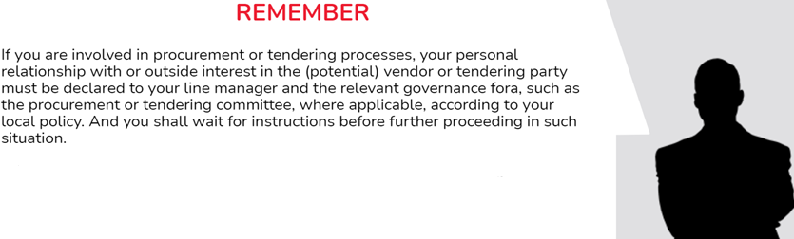
COIs that may arise during vendor selection
Conflicts of Interest Induction Training
Selecting a vendor based on outside interests of an employee, or their own relationship with the vendor, rather than the vendor’s ability to deliver the required service or goods is one of the key employee-related COIs that need proper management.
If you are involved in procurement or tendering processes, your personal relationship with or outside interest in the (potential) vendor or tendering party must be declared to your line manager and the relevant governance fora, such as the procurement or tendering committee, where applicable and according to your local policy. You are required to wait for instructions before further proceeding in such a situation.
ALWAYS
You must always follow required due diligence procedures, vendor selection criteria and disclose any personal relationships or interests in the potential vendors.

Slide 11
Summary of Key Declaration Requirements
Conflicts of Interest Induction Training
You are required to use the COI Declaration Form in StarCompliance to self-declare outside interests and personal relationships that may expose yourself or Prudential to COI risks upon joining the company; and to make timely declarations of subsequent changes including new outside interests and personal relationships that are required to be declared.
This includes, but is not limited to:
Directorships, with or without remuneration, held externally in any organisation outside the Prudential Group
Substantial shareholding (more than 5%), ownership, partnership or sole proprietorship in any organisation
second jobs (full-time or part-time)
Your relatives who are currently employed / contracted by Prudential (including sales agents)
You are also required to declare any actual, perceived or potential COI that may arise while carrying out your duties and refrain from taking any further action prior to obtaining approval to continue with the external interest. Such declarations should be made to line managers and other relevant parties, e.g. Human Resources, Compliance or other relevant functions, as well as to the relevant governance forums such as the procurement, tendering, investment or disciplinary committee, as applicable. Examples of COIs are:
Taking a loan from a subordinate, as such personal financial relationship may (be seen to) inappropriately influence the way the line manager manages this subordinate
Interviewing or hiring a relative or close friends for a position (including contractor or intern) in Prudential
Evaluating or approving Prudential’s engagement with or investment in:
A third party such as vendor or business partner or an investment target in which, you or your relatives or close friends have financial interests; or
A non-government organization or charity, for which you have been nominated to be a member of the executive / management/ advisory committee.

Slide 12
Summary of Key Declaration Requirements
Conflicts of Interest Induction Training
You are also required to declare any actual, perceived or potential COI that may arise while carrying out your duties, and refrain from taking any further action prior to obtaining approval to proceed with the external interest. Such declarations should be made to line managers and other relevant parties, e.g. Human Resources, Compliance or other relevant functions, including governance for a such as the procurement, tendering, investment of disciplinary committee, as applicable.
Having consensual relationships with other employees or contractors as defined in the Consensual Relationships Policy must be declared to HR. Only where such a relationship is assessed to also create a COI does it need to be managed under the COI policy and relevant procedures.
Please complete your initial COI Certification on StarCompliance. You can access StarCompliance via this link, via the link in your StarCompliance welcome e-mail, or via the 1-PRU COI website.*
*Please note that you will be able to access StarCompliance and any of the links on this slide only from a office device and/or within an office environment.

Slide 13
Key COI Controls
Conflicts of Interest Induction Training
Examples of key controls to identify and manage individual COIs are outlined below:
Staff background check, third-party due diligence and personal COI check
In addition to employees' self-declaration, the company conducts staff background checks covering e.g. External Directorships. Furthermore, due diligence is performed on critical third-party engagements that take into consideration the shareholding, directorship and beneficial ownership of such third-parties. Back-end personal COI checks may be performed on a periodic basis on third-parties to identify potential undeclared external interests or relationships from staff.
Information barriers
Segregation of duties
Information barriers are designed to control the flow of information between different parts of an organisation. These barriers can be physical or procedural. Examples are physical separation barriers (by floors, walls, dedicated rooms) of functions within Prudential, and effective IT security control procedures that allow only certain groups of staff to access certain information.
Each employee's role and responsibilities should be clearly defined and should not require an employee to be involved in separate services or activities that would impair the proper management of conflicts. For example, it would be inappropriate for an employee to act as both the preparer and approver on business transactions and deals. Generally, these duties must be segregated.

Slide 14
Key COI Controls
Conflicts of Interest Induction Training
Examples of key controls to identify and manage individual COIs are outlined below:
Operating rules and system control
Operating rules are embedded in day-to-day processes that ensure that e.g. claims are not assessed by a relative of the claims submitter, an internal investigation into an agent’s or staff’s malpractice is not performed by a close friend. In addition, system controls are put in place by LBUs to ensure employees are not able to review their own policy applications or claim requests.
Oversight
Oversight and monitoring help in preventing COIs from materialising. For example, maker-checker controls in the underwriting and claims handling process support ensuring a fair process. Furthermore, reviews from the second and third line as well as oversight by relevant governance forums help identify potential COI issues and gaps in controls that manage key COI risks.
COI risk assessment
A COI key risk register that includes all key COI risk scenarios faced by the business as well as the relevant key controls is maintained and reviewed regularly with input from all relevant business functions, with the result reported to senior management and relevant governance forums where required. Any material control gaps identified during the risk assessment are required to be properly followed until they are resolved.

Slide 15
Summary of Key COI Requirements relating to Employees / Contractors
Conflicts of Interest Induction Training
The Board and executive management of the Group and all BUs / LBUs are subject to the Group COI Policy and:
Are responsible for implementing an appropriate COI programme in line with the requirements of the Policy and in compliance with applicable laws and regulations
All employees are:
responsible for identifying and managing COI. The existence of a COI should not adversely influence an employee’s judgement and objectivity in the performance of their roles and responsibilities. Even the perception that personal interests influence business judgement could be detrimental to Prudential or to its key stakeholders such as customers, shareholders, investors and employees.
Employees and contractors:
Need to identify and where possible avoid situations that could result in COI, unless the conflict is disclosed and managed under the BU’s / LBU’s COI framework.
Need to notify their line manager or HR or any other designated person as specified in BU / LBU procedures, whenever they identify a conflict so that steps can be taken to manage the situation.

Slide 16
Group Conflicts of Interest Policy and Group Compliance Standards (GCS)-30
Appendix 1

